Slide 1
Machine Learning - Project Customer Segmentation
Group 10
Pavan Kalyan Yakkali (2249432)
Pavani Daggula (2296650)
Sai Praneeth Varma Kalidindi ( 2293812)
Naga Venkata Pavan Thollamadugu (2259170)

Slide 2
Introduction
This project focuses on the analysis of existing products dataset from the Kaggle repository.
Data set – Customer Segmentation, KAGGLE
The dataset is a comprehensive collection of behavior related data of existing clients.
Importance
The analysis of this dataset is crucial for understanding customer behavior and preferences.
It provides insights that can help to new customer dataset with same marketing strategies and improve customer engagement.
Objective
Our goal is to classify all new customers into 4 meaningful segments with same strategy that is used to present clients, by using trends of current dataset, and provide actionable recommendations.

Slide 3
Dataset: Customer Segmentation
Dataset Characteristics:
Multivariate
Associated Tasks:
Classification
Feature Type:
Categorical, Integer
# Instances:
8054
# Features:
12
The data is related to customer behavior related like age, experience, married, graduated...
The dataset had different types of client data like age, ID, Ever_married, Graduated, Profession, Gender, Work_exp, Spending_score, Family_size, var_1, One output variable y that denotes if customer is related to which Segmentation(like A,B,C,D).
The classification goal is to classify the new customers into different segments.

Slide 4
Approach & Methodology
Pre-processing
EDA
Handle Missing Data
Check for and remove duplicate values
Encoding Categorical variables
Form visualisations
Histograms
Pie Charts
Correlation matrix
Conclusions on the Model impact on the output
We used 6 models to compare the result.

Slide 5
Data Cleaning:
Missing values : There are Total 1506 missing values in the data set
Duplicated values : No duplicated values found.
Here, we replace the null values by comparing with other variables like (groupby) function and analyze them.
We used one hot encoding technique to convert categorical in to numeric.
Outliers are negligible in age and work_exp.
Scaling (standard scalar) the variables to train the model.

Slide 6
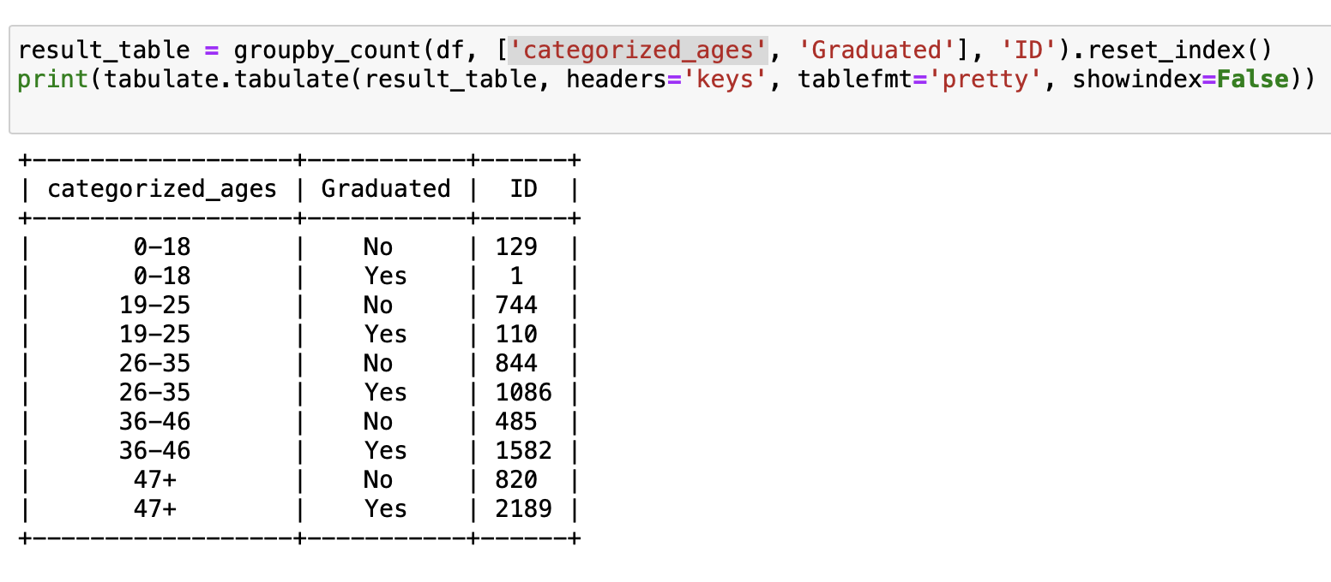
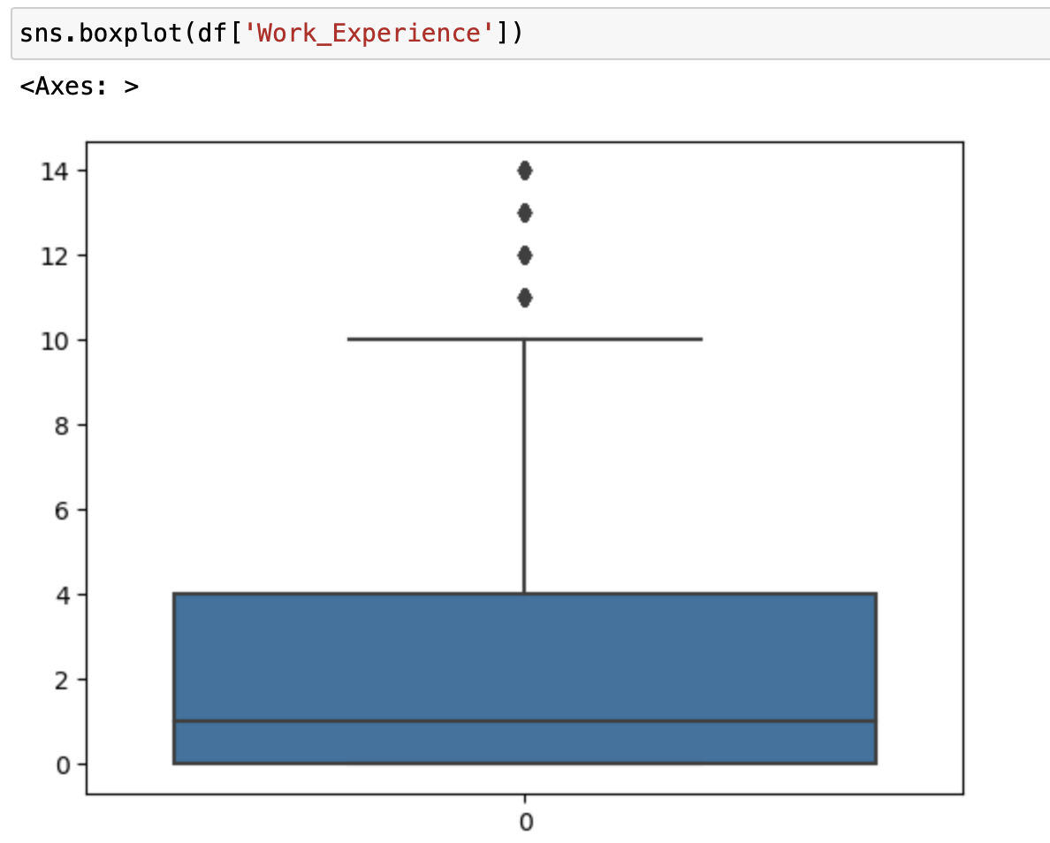
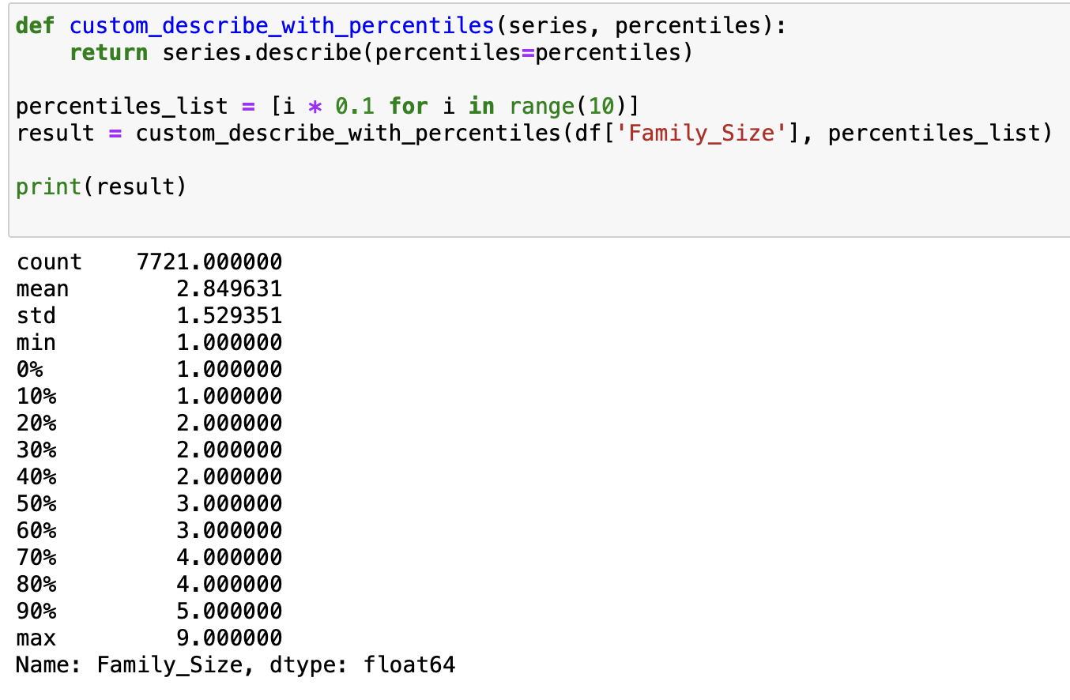
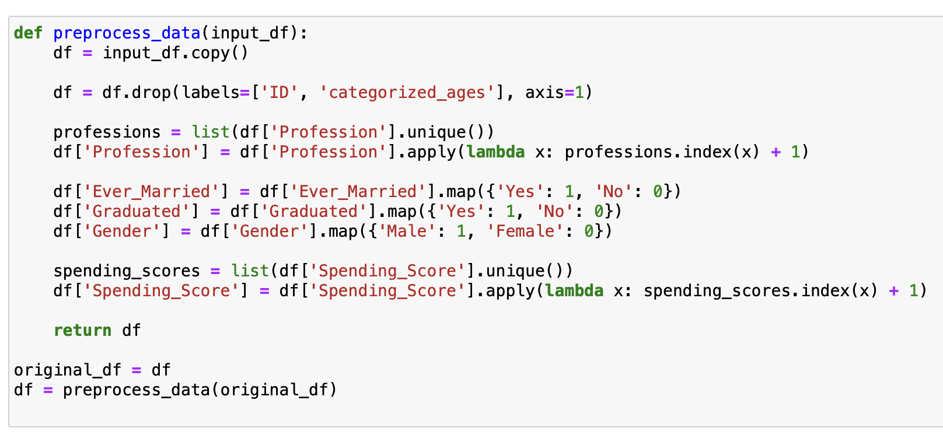
Replacing null values with related one by comparing others
Outlier’s detection for numeric columns and they doesn’t impact on training
Replacing numeric null values by using padding
Here we do Encoding

Slide 7
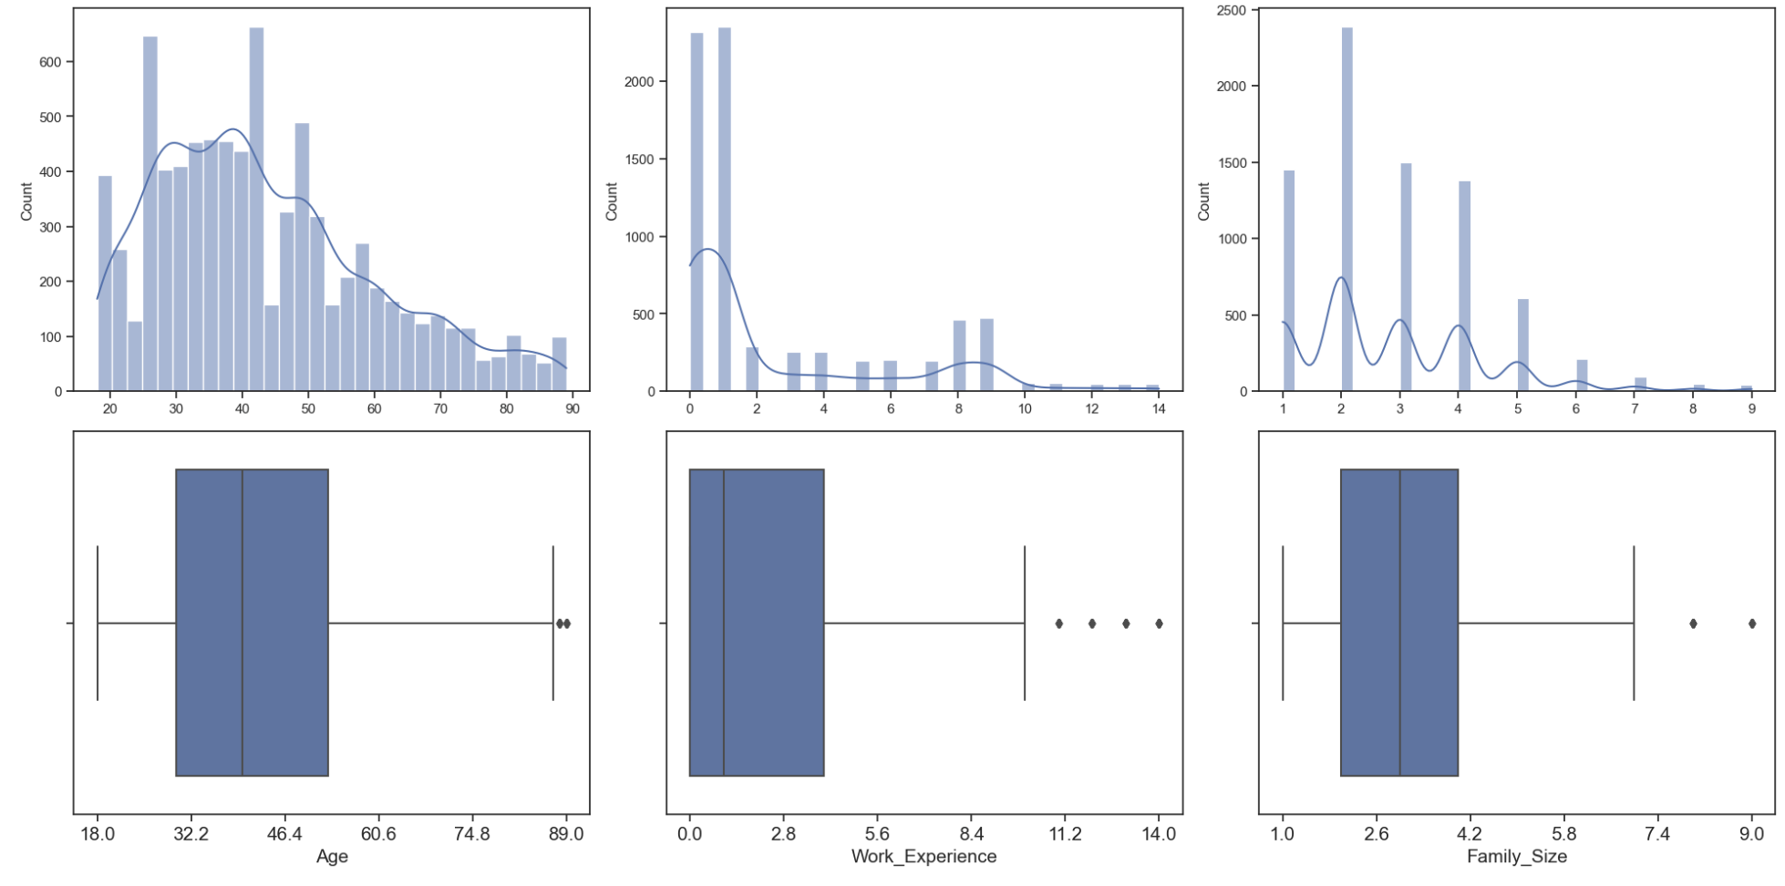
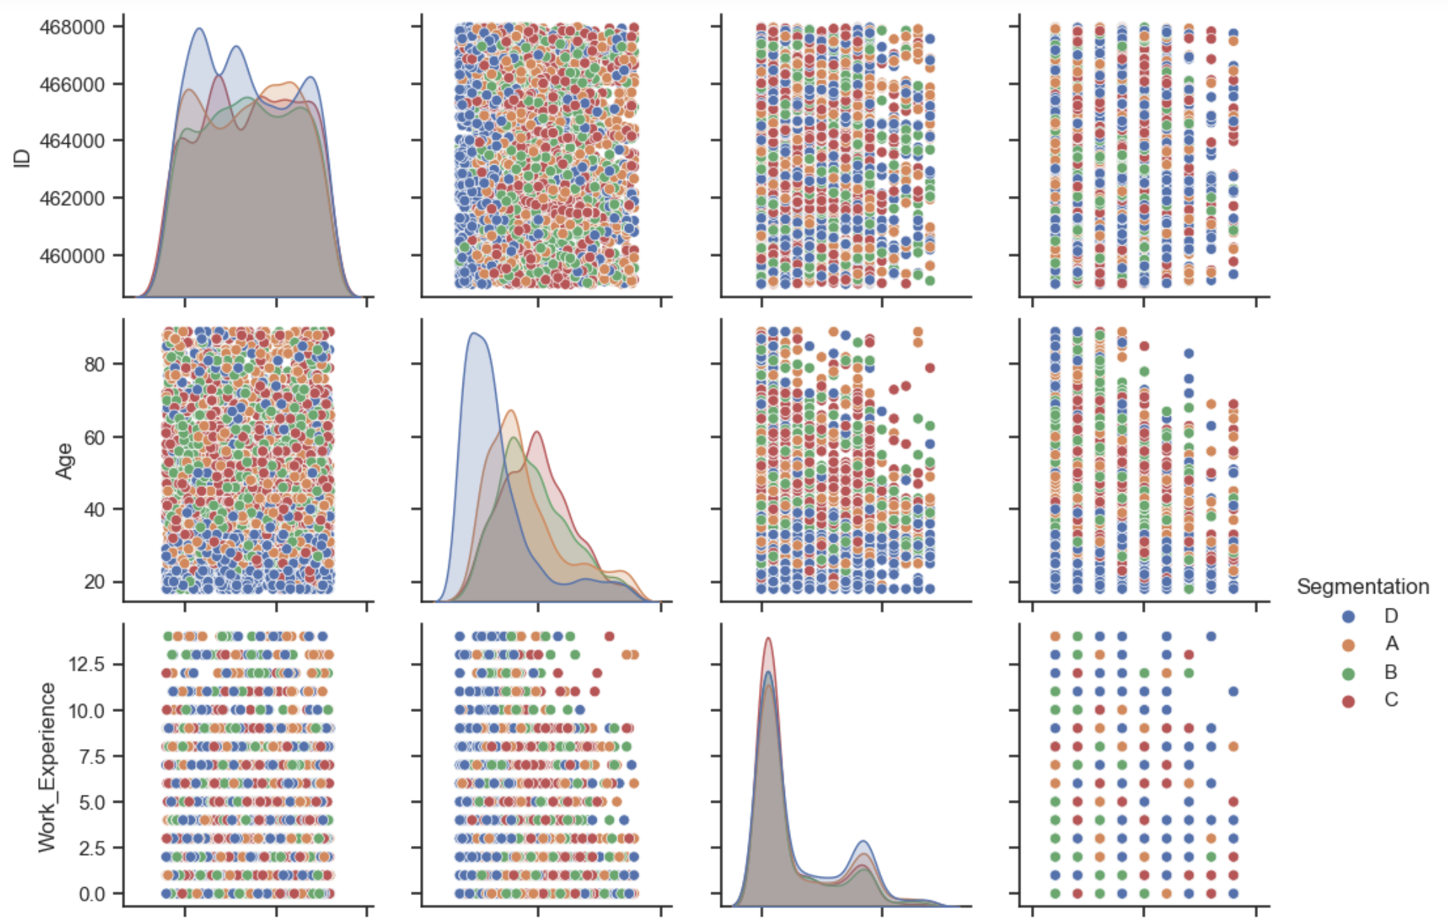
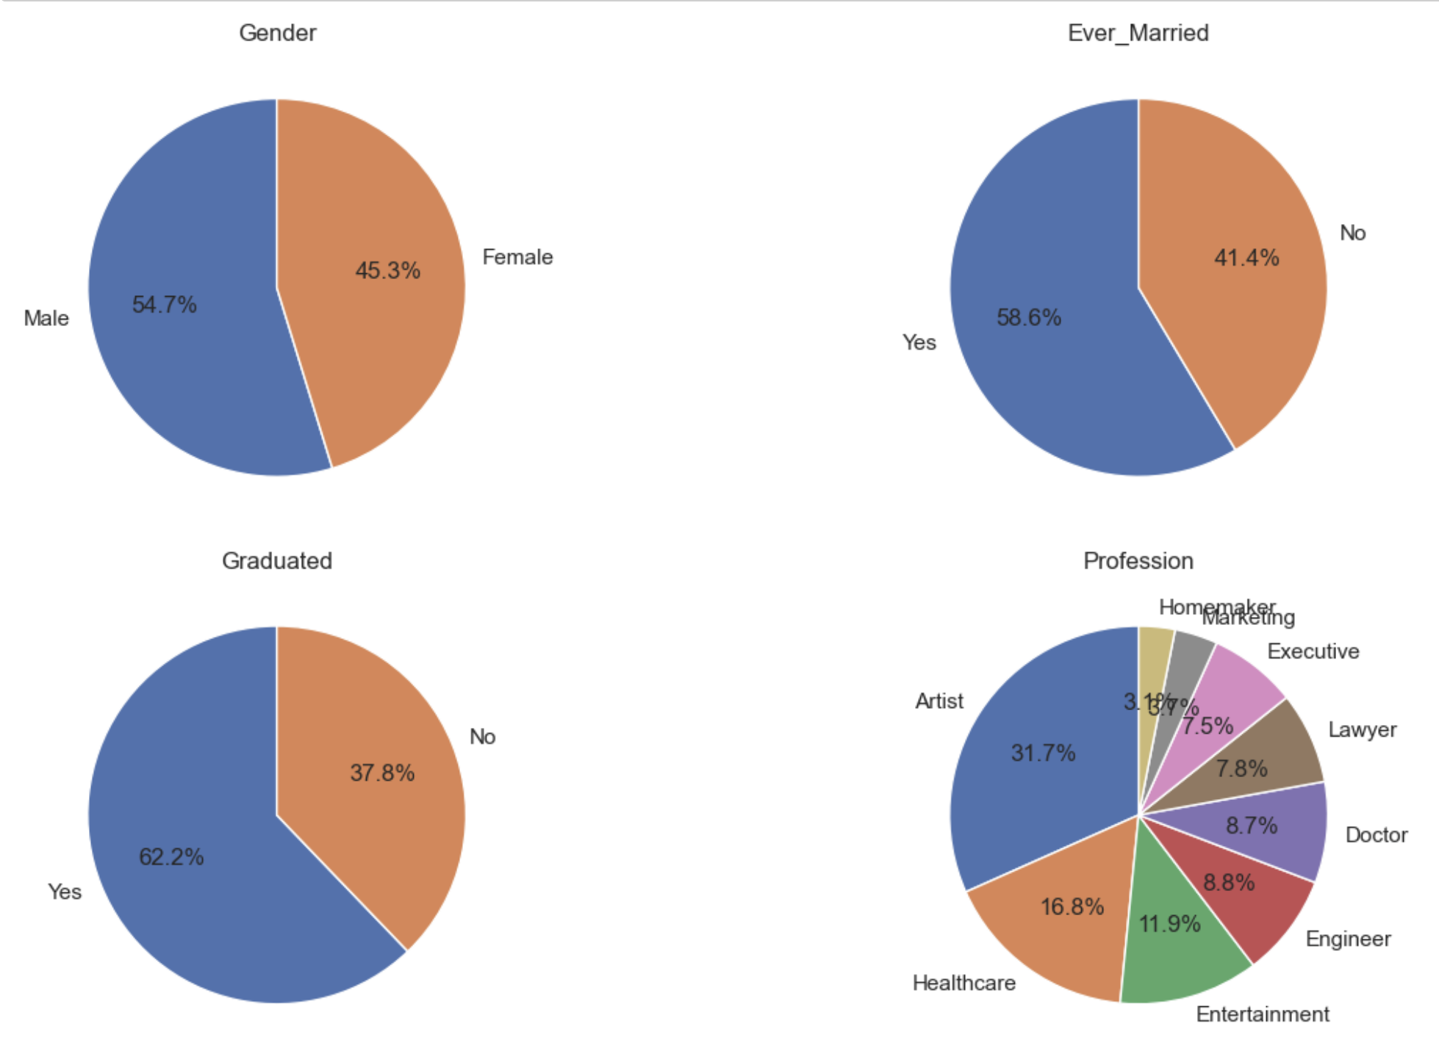
Visualisations
Count plot and box plot of numerical columns
Categorical and numerical by visualisation
Values distribution of each column using pie chart

Slide 8
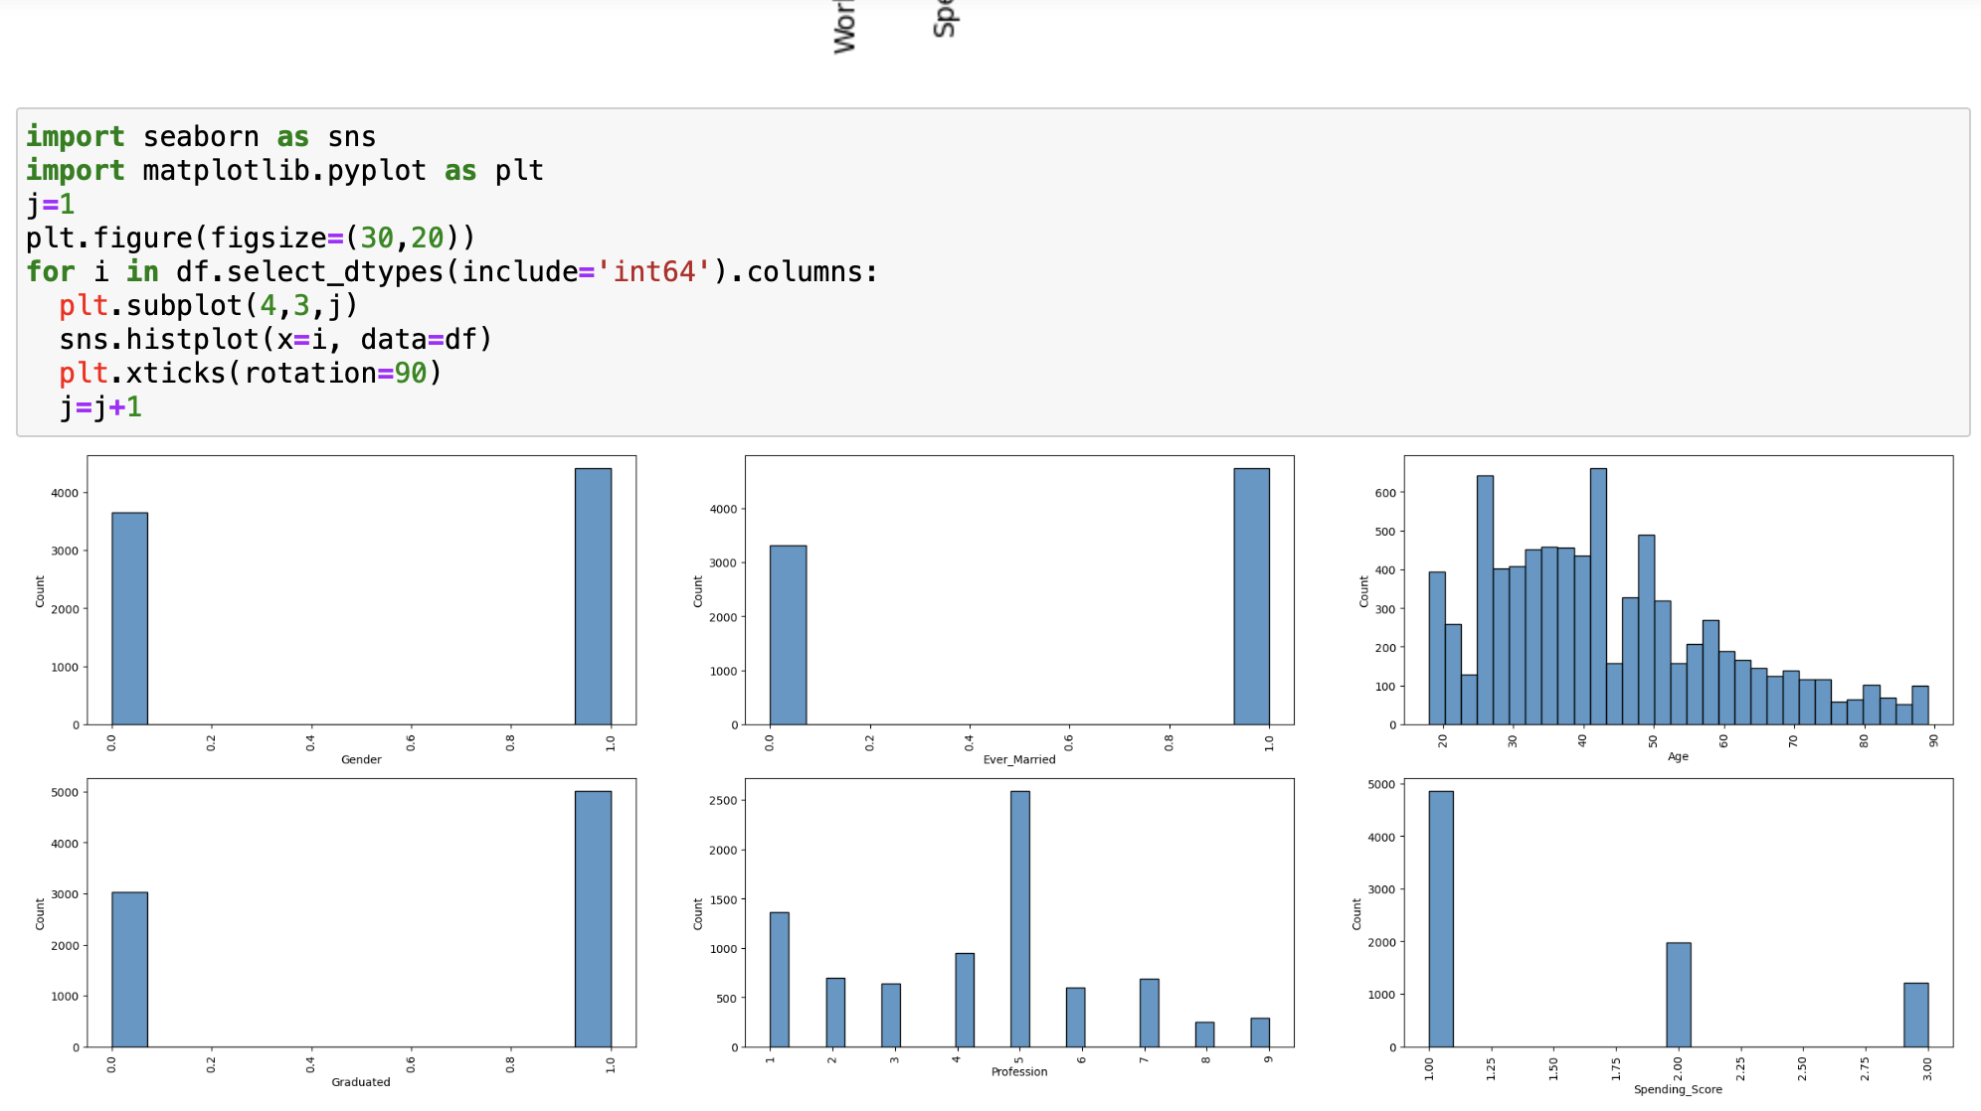
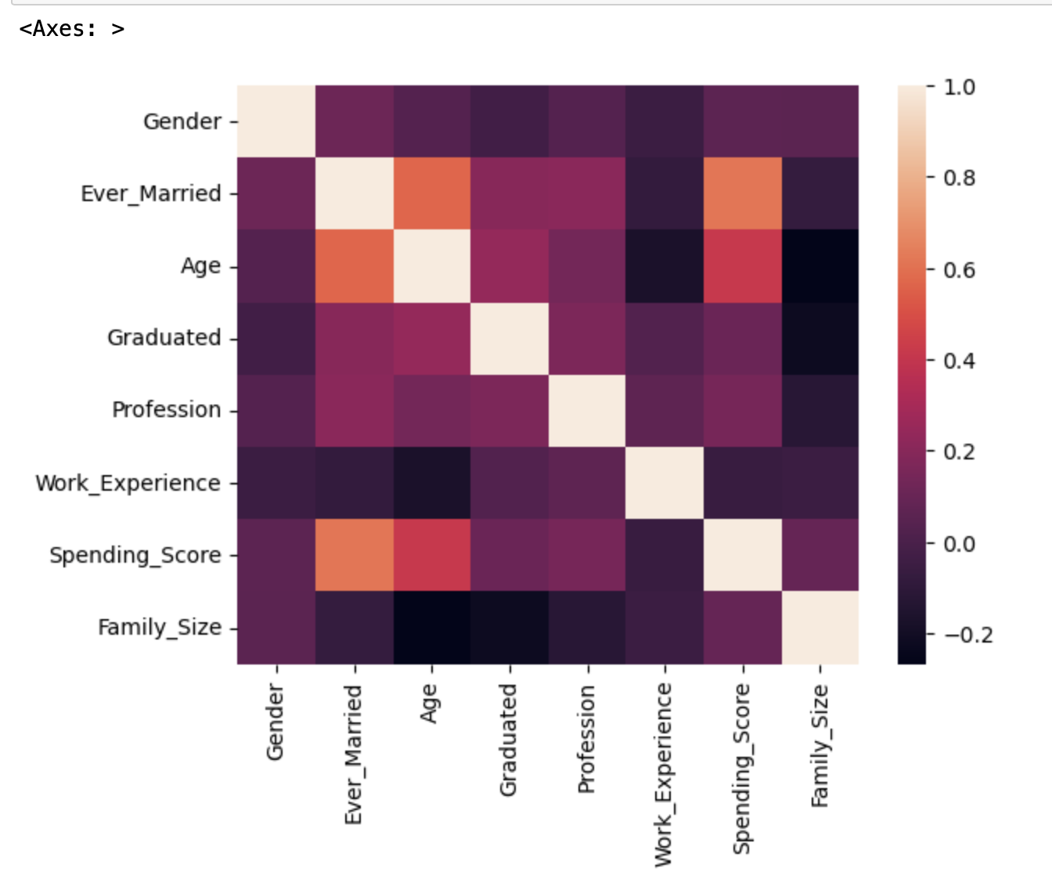
EDA
Count plot of variables
HeatMap with correlation cofficient

Slide 9
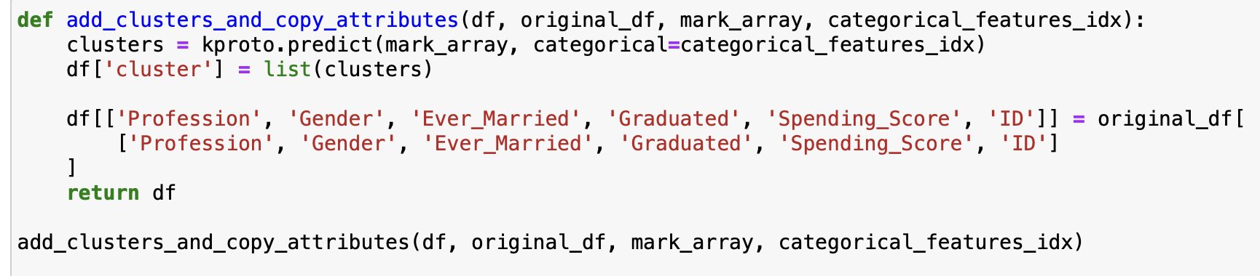
Model training
In this project, this is completely related to classification.
Here we first used k-prototype algorithm to classify into 4 segments. In K-Prototypes clustering, the objective is to minimize the total dissimilarity between data points and their assigned cluster prototypes (centroids).
K-Prototypes is an extension of K-Means that can handle datasets with both numerical and categorical features.
It refers to the prototype algorithm, More information provides when more details given.
Training the model
Here, we are predict the segments and converting the encoded to original
NCOST

Slide 10
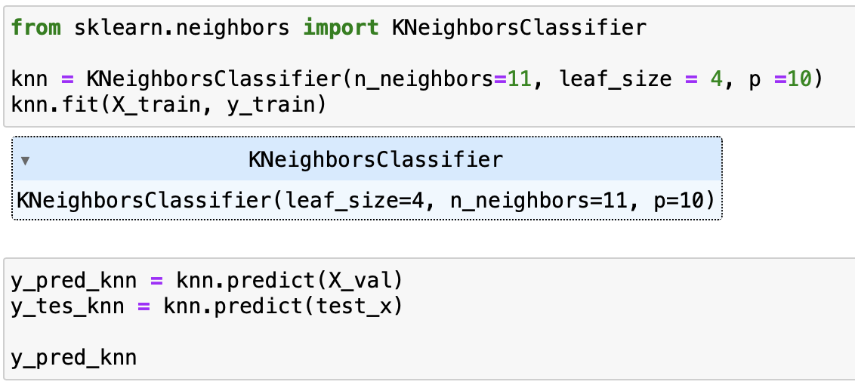
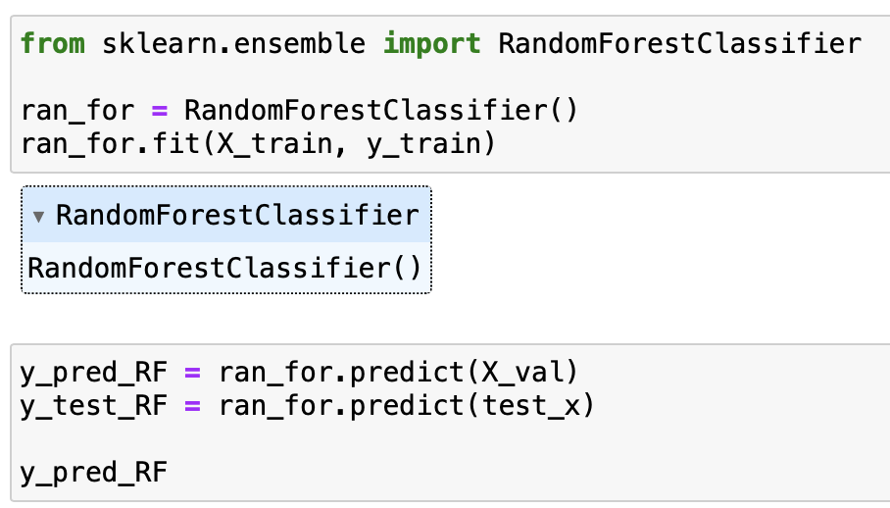
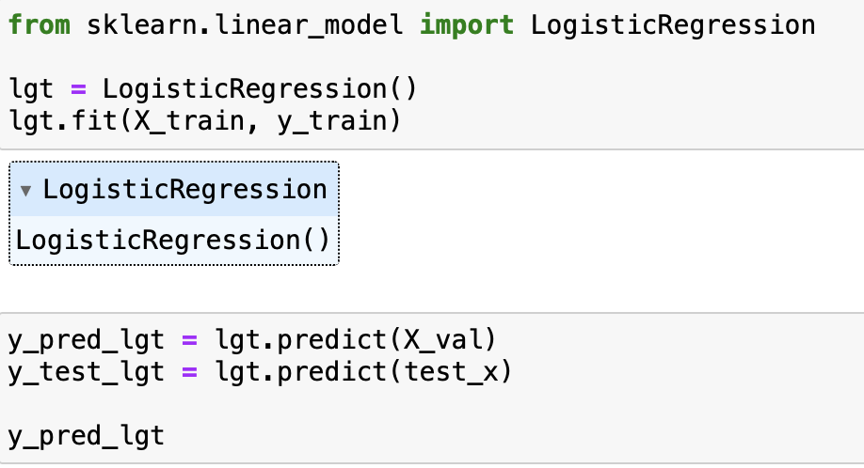
MODEL TRAINING
Here we trained KNN with 11 neighbors
Here we trained Random Forest
Logistic regression

Slide 11
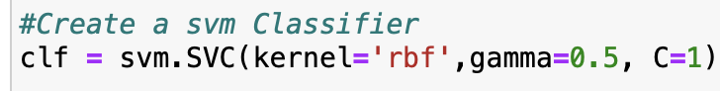
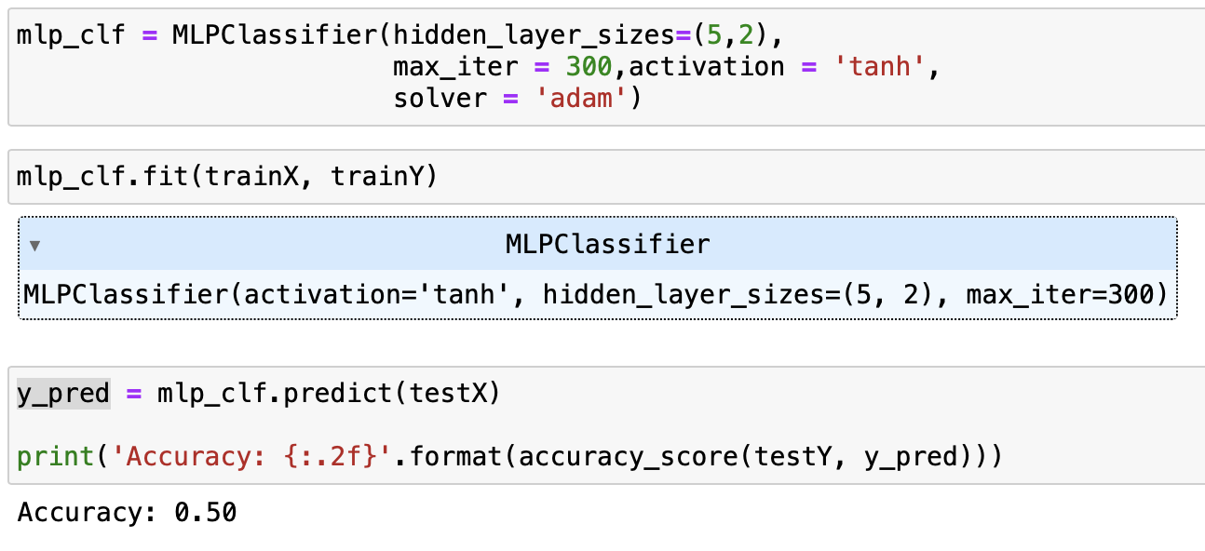
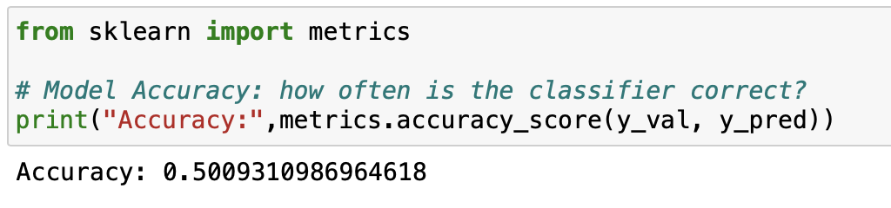
Model Training & Evaluation (SVM, MLP)
SVM finds the hyperplane that best separates the data into different classes.
Adjusting parameter’s, SVMs are powerful but can be sensitive to the choice of parameters, especially the kernel and regularization parameter (C).
MLP is feedforward neural networks and consists of an input layer, one or more hidden layers, and an output layer.
In MLP, adjusting various parameters, such as the number of hidden layers, the number of neurons in each hidden layer, activation functions, and regularization parameters.(Cost function= 1.1)
Accuracy score of MLP classifier
Accuracy score of SVM

Slide 12
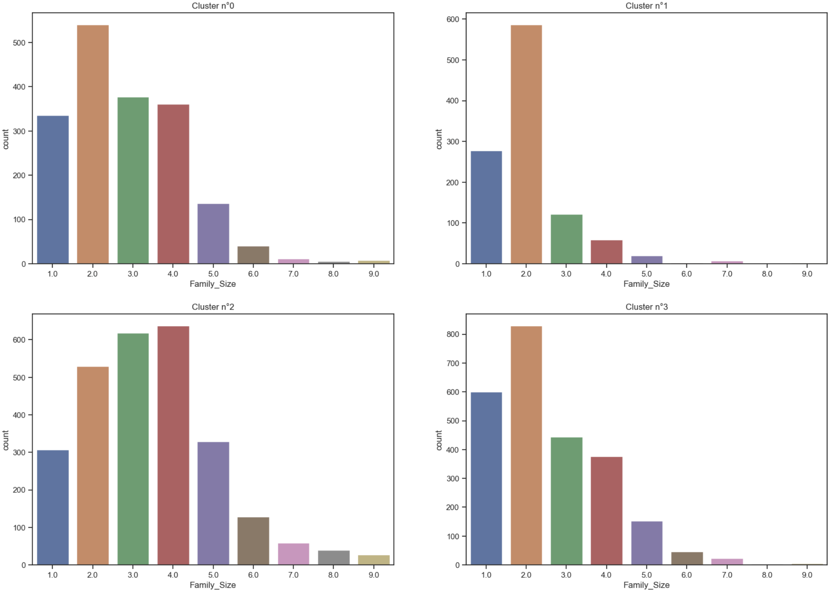
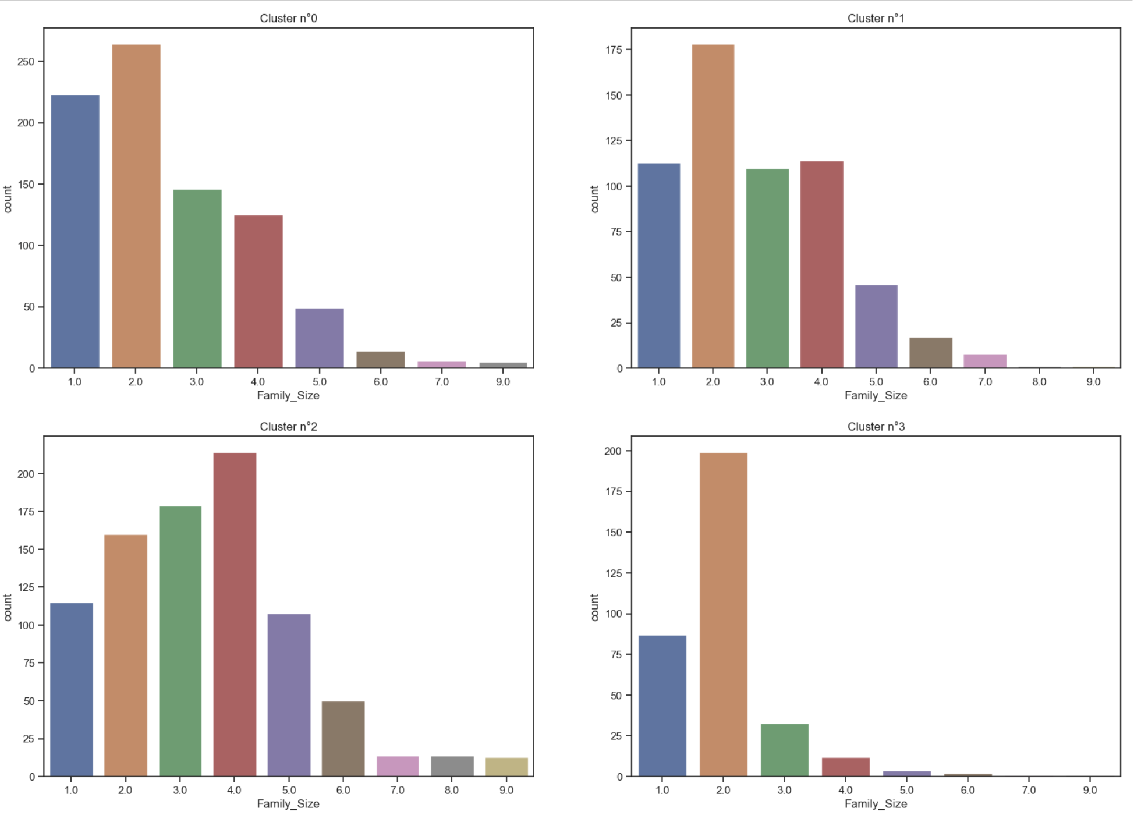
Model Evaluation
Family_size classification with training dataset
Family_size classification with Test dataset
Here, we observed the classification in training and test dataset is almost similar

Slide 13
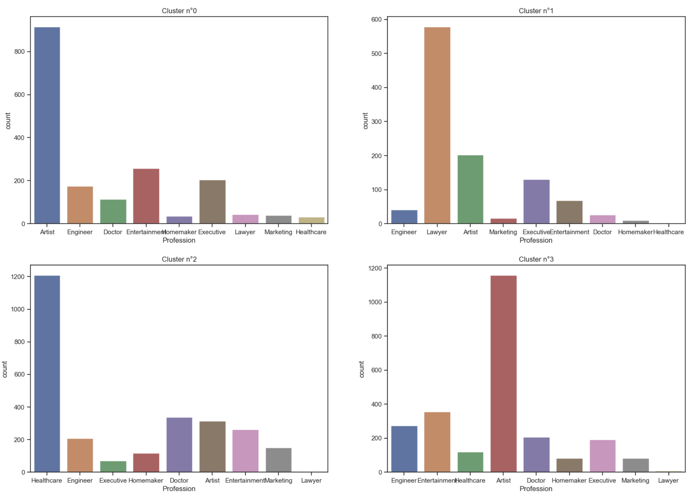
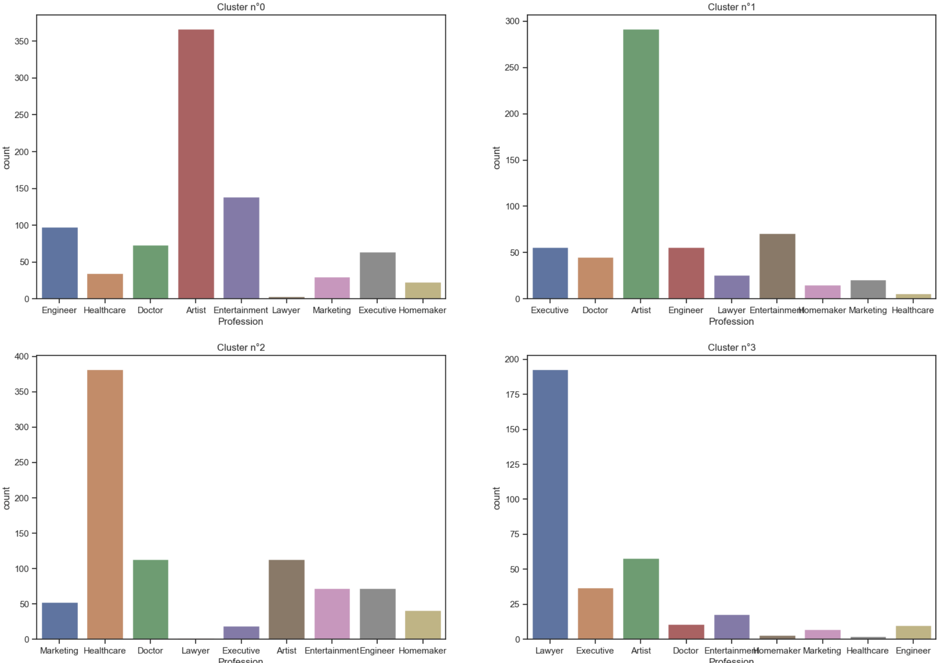
Model Evaluation
Family_size classification with training dataset
Family_size classification with Test dataset
Here, we observed the classification in training and test dataset is almost similar

Slide 14
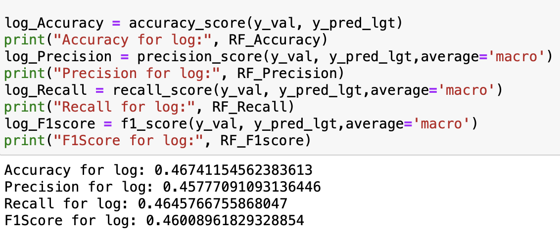
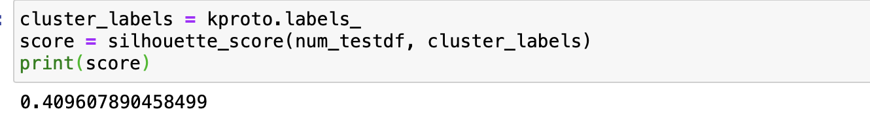
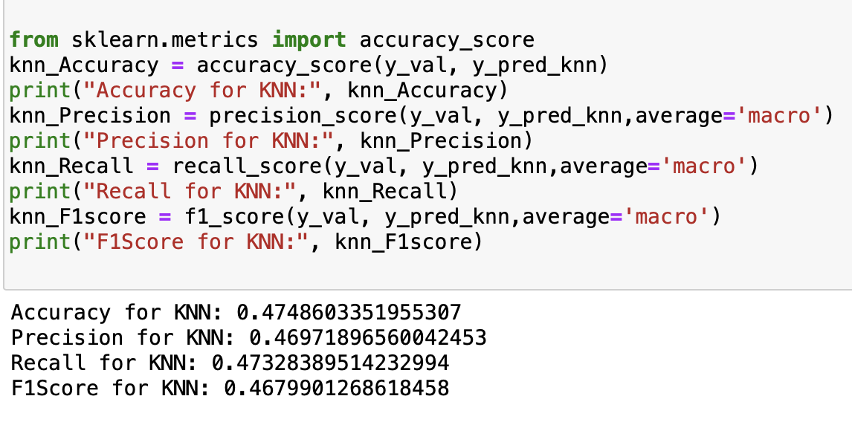
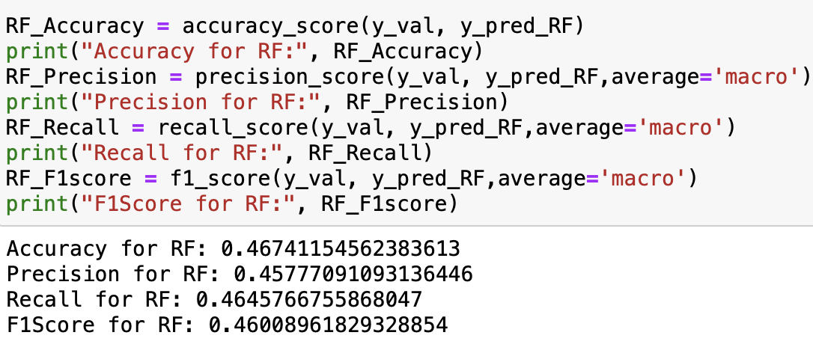
Model training with results (K-prototype, KNN, Random Forest, Logistic)

Slide 15
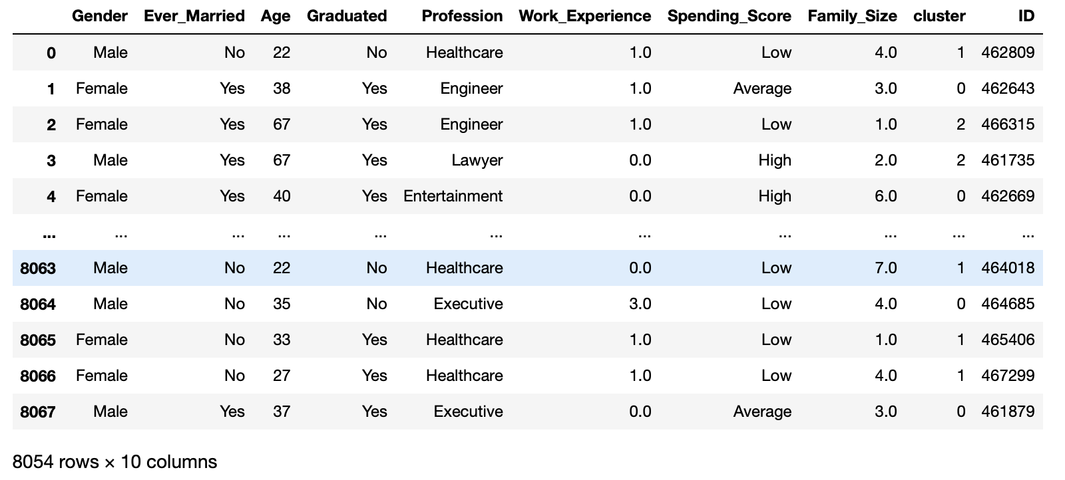
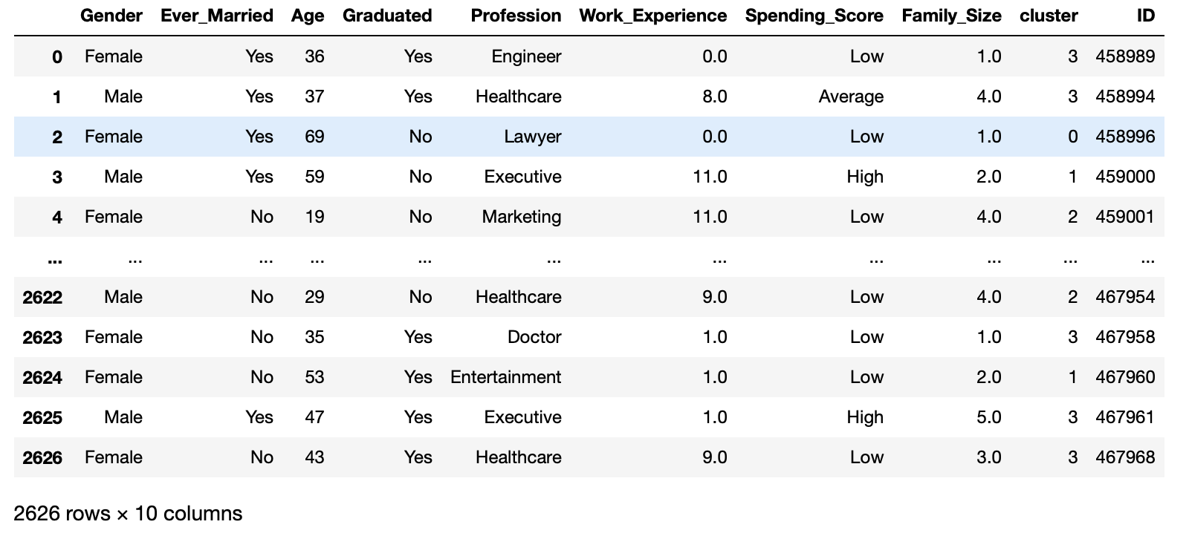
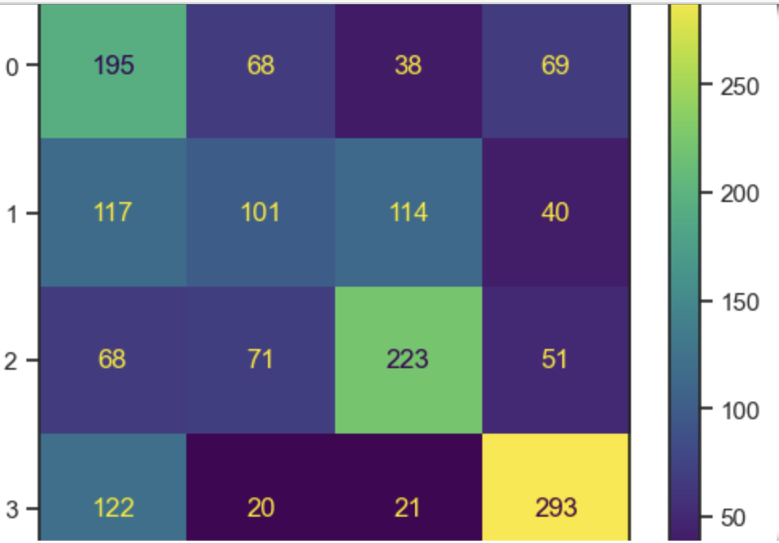
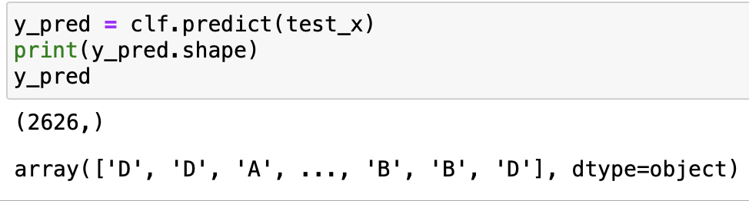
Results of models with good accuracy (K-prototype, SVM, MLP)
Confusion matrix of MLP classifier
Predictions of SVM Classifier

Slide 16
Conclusion and Future scope
The study showed that using SVM and MLP algorithms effectively expands consumer segmentation tactics into new areas.
The discrepancies in clusters 2 and 3 suggest that increasing data or adding relevant factors could improve accuracy in k-prototype Algorithm.
The project's results enable the vehicle firm to target new customers, enhance marketing efforts, and boost customer engagement in the new market and we can improve the classification by increasing the number of data points or variables.

Slide 17


